Slide 1

AI Essay Detector and Humanizer
By: Nidhish Shah, Junfeng Li, Cole Smolinski, Stephen Hannawi

Slide 2

With the rapid advancement of AI writing tools such as ChatGPT, Google Gemini, and Claude, it has become increasingly difficult to distinguish between human-written and AI-generated content in academic writing. Although these tools are useful for brainstorming and organizing ideas, their outputs often sound overly polished, repetitive, and standardized, which can make them feel less natural than human writing.
Problem Statement
Notes:
I did make it less repetitive and more orginized

Slide 3

Our Solution
Our solution was to develop a web application that combines AI text detection with text humanization. The app can identify likely AI-generated content and then rewrite it in a more natural, human-like style while preserving the original meaning.
We designed the project with the following goals:
Build a functional full-stack AI-powered web application
Provide measurable AI detection results
Implement meaningful text transformation while preserving semantic content
Evaluate system performance using real test data
Notes:
I wrote it in more clear way.

Slide 4
Related Work
We reviewed several tools and research efforts related to AI text detection and humanization.
For AI detection, GPTZero was one of the earliest widely used tools for identifying whether a text was likely written by a human or generated by AI, using measures such as burstiness and perplexity. Similarly, Sapling AI provides a detection API that estimates the probability that a piece of text is AI-generated.
For humanization, prior research has explored paraphrasing and rewriting methods using models such as T5 and PEGASUS while preserving meaning. More recent models, including GPT-4 and LLaMA, have also shown strong performance in style transfer and text rewriting.
Our project is different from prior work because we combined both detection and humanization in a single web application. In addition, it includes a quantitative measure of text change after humanization using cosine similarity.

Slide 5
Methods
The system provides two core features:
1. AI Detection
Users paste an essay into the application
The text is analyzed using the Sapling AI Detection API
The system returns a score (0–100%) indicating the likelihood that the text is AI-generated
2. Humanization (Humanizer)
The essay is sent to the Groq LLaMA 3.3 70B model
The essay is rewritten to sound more natural and human-like while preserving the original meaning
A rewriting analysis shows how much the wording changed compared to the original

Slide 6
How AI Detection Works
We use the Sapling AI Detection API to analyze text.
The model outputs a probability score (0–100%) indicating how likely the text is AI-generated.
The detection is based on statistical patterns such as:
Perplexity (predictability of text)
Burstiness (variation in sentence structure)
AI-generated text tends to be:
More consistent
More predictable
Less diverse in phrasing
Output Interpretation:
Score > 70% → AI Generated
Score < 40% → Human Written

Slide 7
How Rewriting Works
We use the Groq LLaMA 3.3 70B model to rewrite text.
The model is guided by a prompt to:
Preserve the original meaning
Use more natural and conversational language
Reduce repetitive or overly formal expressions
The goal is to make AI-generated text:
Less predictable
More human-like in style
Key Idea:
Change wording, not meaning

Slide 8
Evaluation
We evaluate using labeled datasets (AI vs Human essays).
For each sample:
Run detection on original text
Rewrite the text
Run detection again
Metric:
Score Drop = Original Score – Rewritten Score
A larger score drop indicates:
The rewritten text is harder to detect as AI
The humanization is more effective

Slide 9
Similarity
We use cosine similarity (TF-IDF) to compare:
Original text
Rewritten text
Formula:
Words Changed (%) = (1 - cosine similarity) × 100
This ensures:
The meaning is preserved
Only wording is modified

Slide 10
Results (Dataset + Accuracy)
Dataset: Human vs AI Generated Essays (Kaggle)
Total samples used: 100
50 AI-generated
50 human-written
Minimal preprocessing:
Truncated to 2000 characters (API limit)
Detection Accuracy:
90% overall accuracy
Observations:
Most AI-generated texts were correctly identified
Errors mainly occurred as false negatives (AI → Human)

Slide 11
Results (Rewrite Effect)
We compare detection scores before and after rewriting
Example Results:
Sample 1:
Before: 100%
After: 82%
Drop: 18%
Sample 2:
Before: 90%
After: 75%
Drop: 15%
Summary:
Average word change: 65–75%
Rewriting reduces detectability, but:
AI text is still often detected

Slide 12
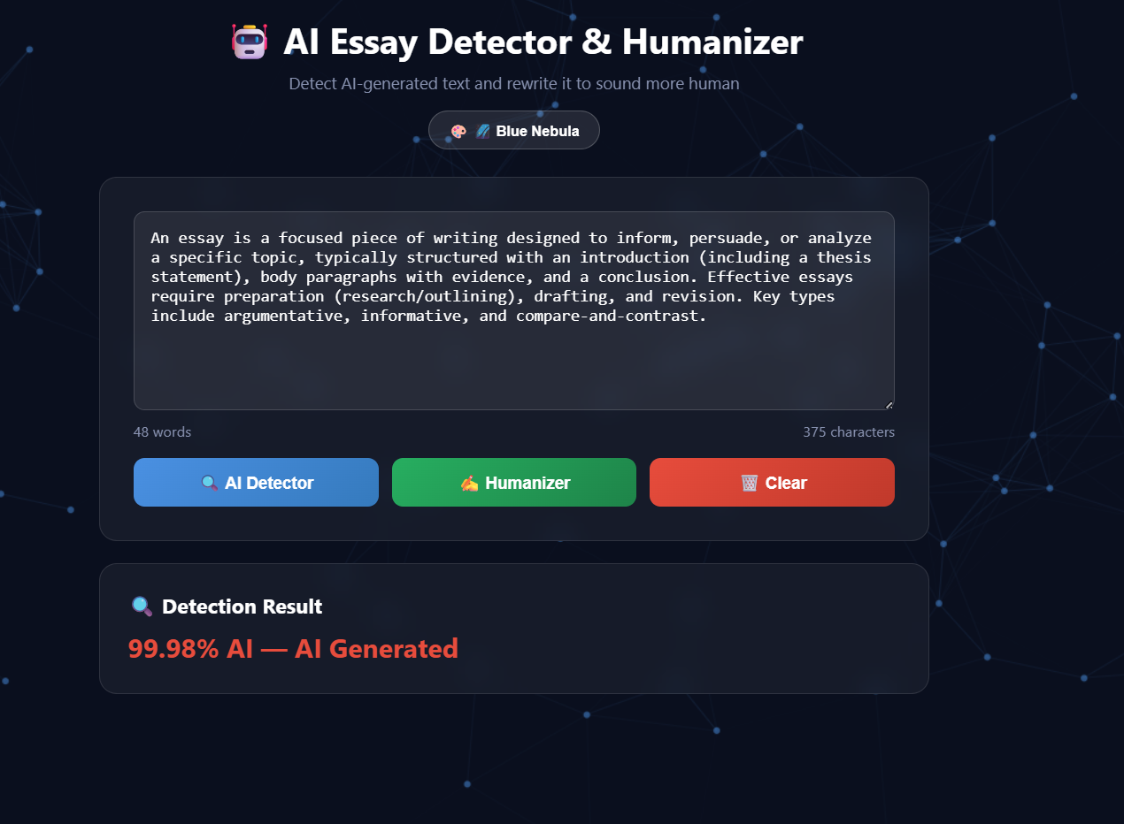
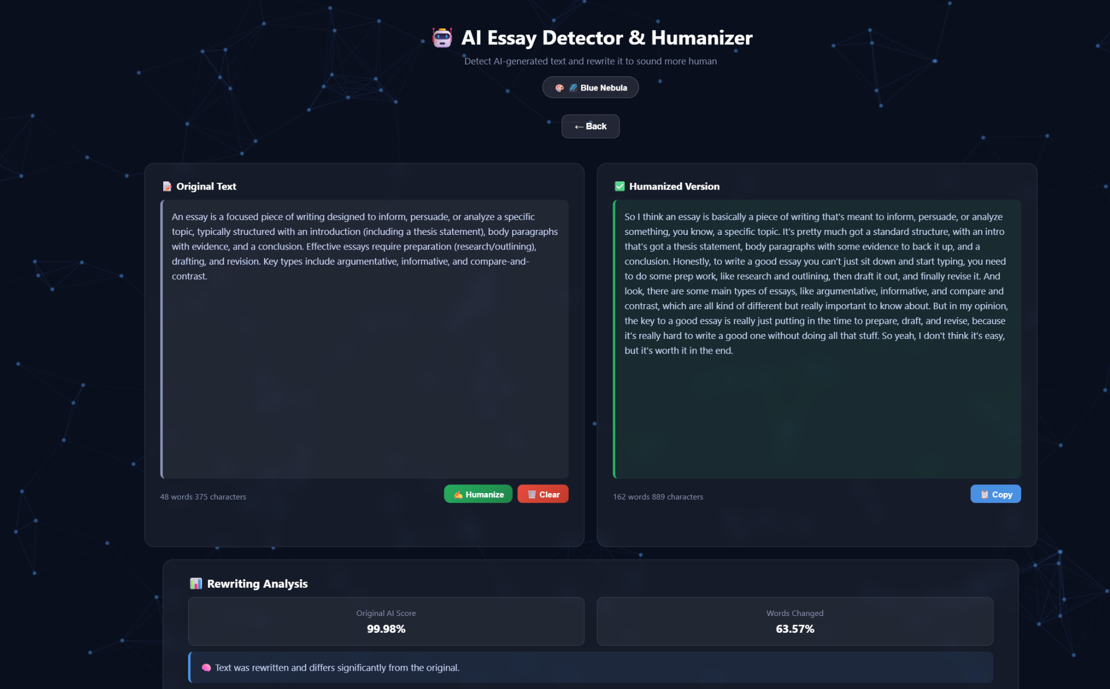
Results and Demonstration

Slide 13
Live Demo
Step 1: Detection
Input AI-generated text
Detector outputs high AI probability
Step 2: Humanization
Click “Paraphraser”
Text is rewritten using LLaMA model
Step 3: Analysis
Compare original vs rewritten text
Observe wording changes and score differences
Key Insight:
Rewriting improves naturalness
But does not fully bypass detection

Slide 14
Broader Impact & Future Work
Being able to detect the percentage of AI-written content in an essay is a useful tool for academic integrity and allowing others to find how much content was generated by AI. However, we also added the ability for this application to work backwards and paraphrase information to make the information in an essay sound more “human” in it’s way of speaking. This could allow for an AI to take an essay and explain it in more natural language without the loss of the important information in the essay.
Future work is to Integrate a more powerful detection model trained on paraphrased content, Add sentence-level highlighting to show which parts of the text are most AI-like, Support file uploads for .txt and .pdf documents, Deploy the application online for broader accessibility and Expand the evaluation dataset to 500+ essays for more statistically significant results

Slide 15
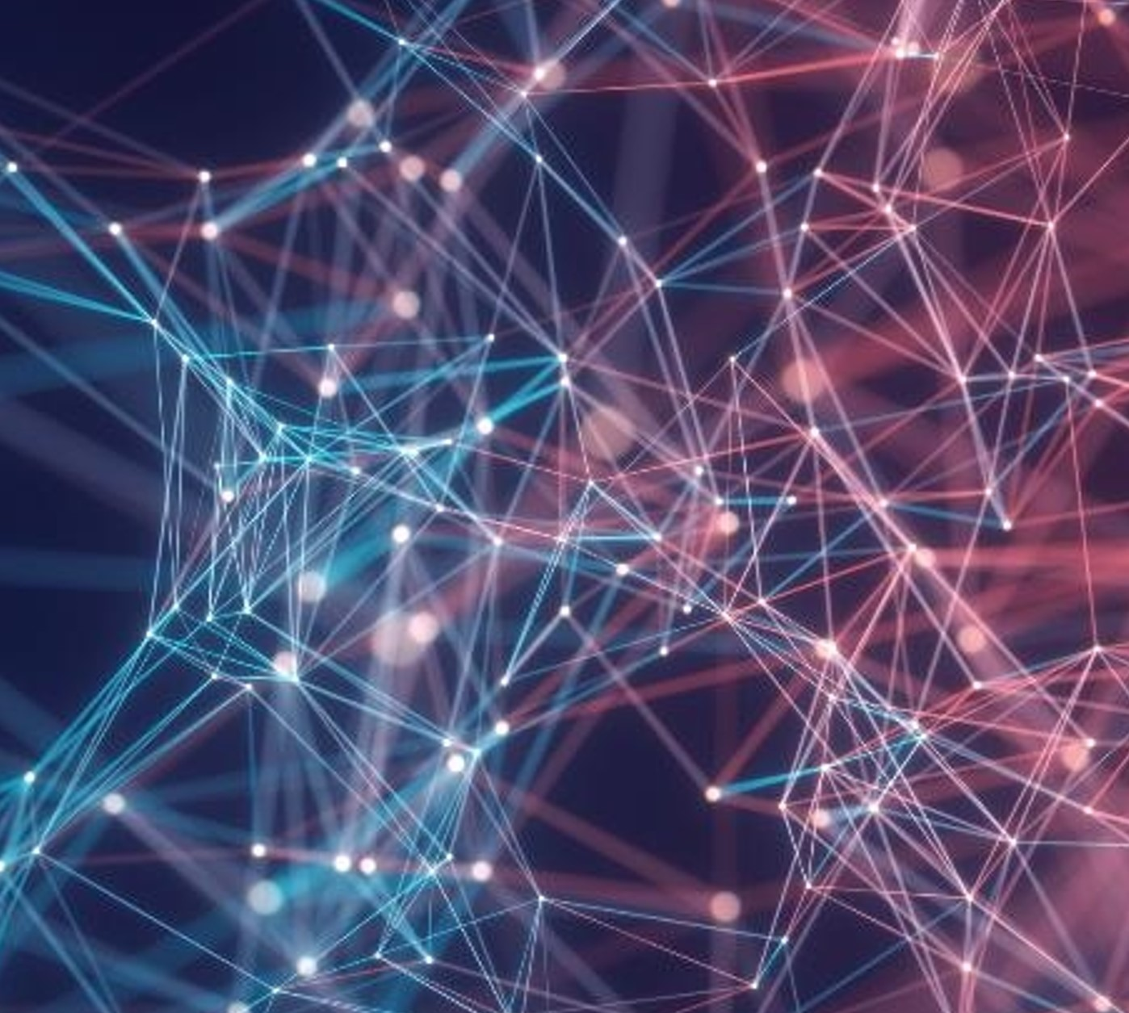
Conclusion
For this project we successfully developed a web application that combines AI text detection and humanization into a single interactive tool. The detection module was able to reach 90% accuracy when run on an unlabeled dataset from the real world. The humanization module, based on the Groq LLaMA 3.3 70B model, was capable of rewriting texts in a more natural way with the number of modified words ranging between 65-75% per test sample.
Limitation: The primary drawback is that the Sapling detector always detected AI-generated text as such, which indicates that existing humanization methods are inadequate for fooling advanced detectors. Another limitation is that there are rate restrictions when using Sapling’s free version.

Slide 16
Thank you!

